Slide 1
MEDIDATA RaveX
Corneel Coens
StatsClub 08/05/2018

Slide 2
Introduction

Slide 3










Medidata Platform
Resource Management
Strategy & Planning
Build & Set-Up
Execution
Site Quality Management
Optimize study design
EDC/CDMS
Contracting
Targeted SDV
Study Build
Monitoring
Global Library
Safety Gateway
Reports & Extracts
Mobile health
Predicted Recruitment
Site Payments
eLearning
Legacy/Third-Party Systems

Slide 4









iMedidata: Overview
Log-in accessible from any computer, any browser
Zero Footprint at Client
No hardware provisioning
Platform Independent
No software provisioning
Browser Independent
No version maintenance
→ www.imedidata.com
Notes:
iMedidata is a Medidata hosted Clinical Management portal designed to provide an enhanced user experience for all Medidata Software offerings
Offers single access point with username and password to:
All RaveX studies
Other Medidata apps
Third party applications via iMedidata API
It offers self-serve, decentralized, online user admin
…and seamlessly integrates with Rave (5.6.3+), all RaveX versions, CTMS, Coder, Grants Manager, CRO Contractor and Balance

Slide 5
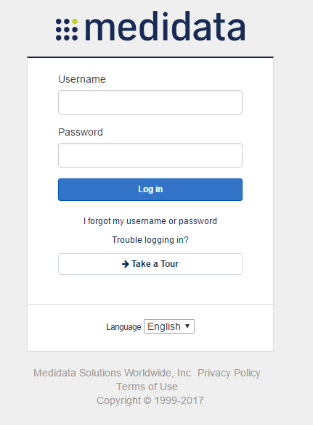
Direct access to iMedidata with a single login
iMedidata information on login page
Notes:
ANIMATIONS…
Sample Log-in page – summarize the slide info...

Slide 6
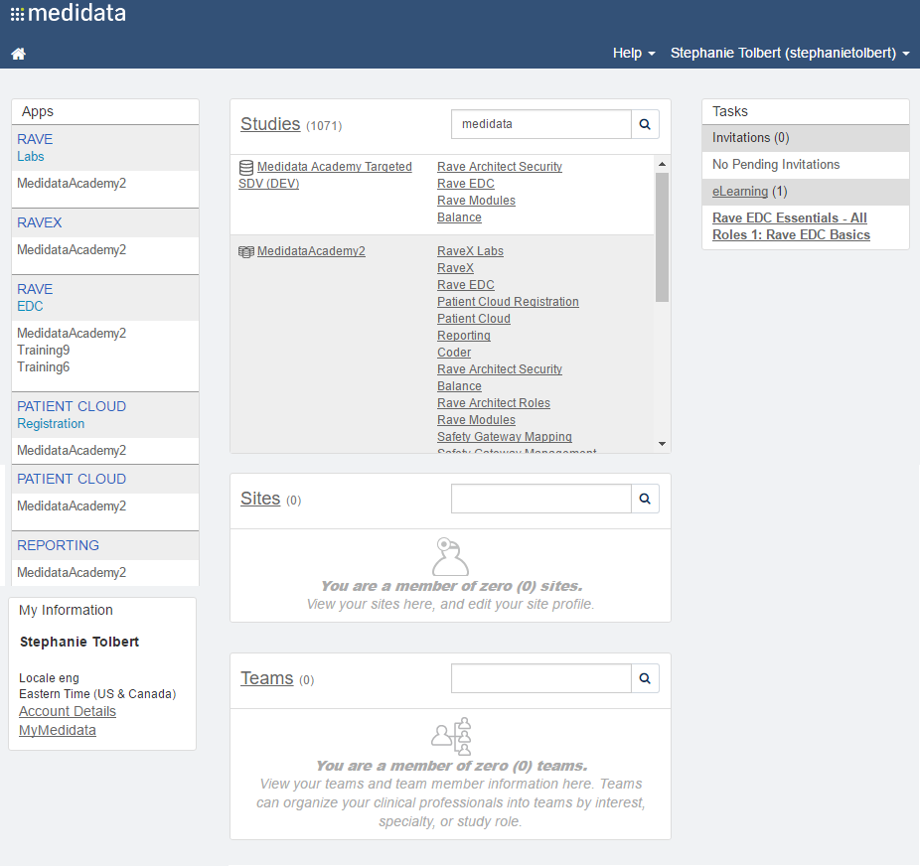
iMedidata: opening screen
Invitations to Studies, Teams, Apps, and Sites
All Optional and required eLearning
Direct access to RaveX URL
Direct access to the RaveX study
Site Personnel see their Sites and can update the Site profile information
Shows all user information
Allows grouping by interest, App, and eLearning
Everything is controlled through permissions – everyone’s iMedidata will look different!
Notes:
ANIMATIONS…
Sample Homepage – summarize the slide info...
TRAINER NOTE: Ensure you have set up a new user to demo the invitation process

Slide 7
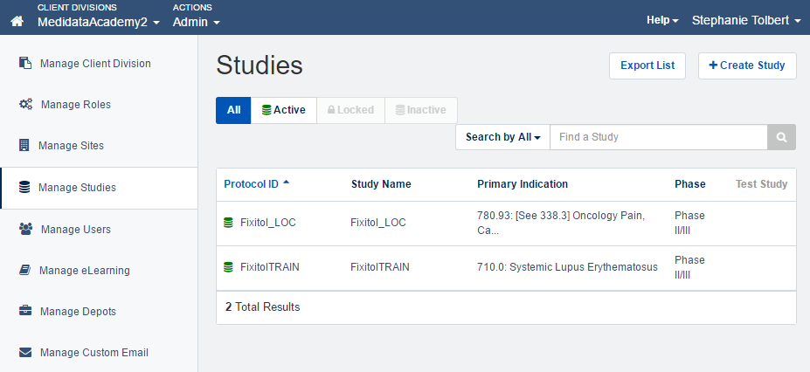
Cloud Administration: Overview
Notes:
Cloud Administration allows admins to manage basic components: Client Divisions, Studies, Environments, Sites, Users, and Roles.

Slide 8
RaveX EDC: Overview
The EDC module is the primary module for end-user data entry and data management for trials
cfr VISTA UPDATE
User roles and workflow are configurable according to Sponsor requirements
One user account can have access across multiple trials with different roles
Allow permissions based on trainings (standard or specific)
Governed by System Administrators
For the site:
Task or Subject based navigation
Intuitive user interface
Notes:
ANIMATIONS…
Roles, responsibilities, and permissions can be controlled across studies or even by site for complete customization and highest efficiency
Navigation can be used in two ways, by:
A listing of all Subjects
A listing of all Tasks that the subject has
Explain Tasks and the Task summary

Slide 9
EDC Task Management
A tool to manage queries and tasks for the EDC modules
Can search for data points across all Subjects at a Site and perform batch actions on the results
Actions include
Forwarding, Answering, Closing, and Canceling queries
Reviewing Pages
Locking Pages
Applying Signature
Must have the correct Role permissions to access and perform actions in Task Management
Notes:
ANIMATIONS…
Task management can be useful for viewing/acting on various data points across a site or for a specific subject at a site.

Slide 10
Data Status
Reviewed – (study dependent) data has been reviewed
Verified – (study dependent) data has been verified
Frozen (soft lock) — Entry lock prevents future data entry or edit.
Site can create and respond to markings (queries & notes).
Sites can only respond to queries in the response box; sites cannot change the data even if the query instructs them to do so.
Data Lock (hard lock) — Hard lock prevents modifying the data in any way.
Sites cannot create or respond to markings.
Investigator signatures can still be applied.

Slide 11
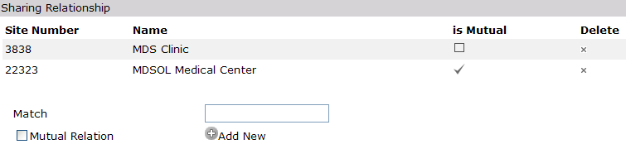
Rave Admin: Subject Sharing
Subjects can be shared across sites within a study
All shared sites can view and enter data for the subject that is shared
Can be a mutual sharing relationship between the Primary and Secondary sites
Sharing across studies is NOT possible (by default)
Notes:
ANIMATIONS…
For various reasons (multiple offices, moving/relocation, snow-birds, etc...) subjects may complete study visits at multiple study-sites
Rave allows subjects to be shared across multiple sites for simplicity of data entry and cleaning

Slide 12
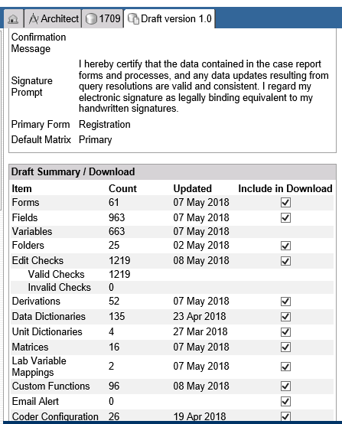
Architect: Overview
Web-based study design and configuration tool
cfr VISTA STUDY DEF + FORM DEF
Self-documenting system
Primary module for initial eCRF and Data Validation Configuration
Configuration privileges are role dependent
Study Developer 1 ONLY has eCRF Configuration and Study Developer 2 ONLY has Data Validation.
Notes:
ANIMATIONS…
Summarize the slide info...

Slide 13
Architect: Key Processes
Step # | Description
1 | Create a new project
2 | Configure Auxiliary environments
3 | Create a new draft
4 | Configure eCRFs (stage 1 setup)
5 | Configure Data Validations (stage 2 setup)
6 | Specify Subject Fields Config settings.
7 | Specify Draft Settings
8 | Associate a test site to the study, associate a test user to the study/site
9 | Publish and push to an Auxiliary environment
10 | Test in EDC
11 | Repeat steps 2 – 9 as needed
12 | When ready to go live, repeat steps 7 -9 using the Production environment
Notes:
Summarize the slide info...

Slide 14
Architect: environment
A study can exist in several environments.
An environment allows to experiment and fine-tune a study before moving it to production.
Each environment in a study has its own unique data set and inventory control, as well as users and sites, but all the environments in the study share the same configuration type (roles for specific modules).
Typical environment:
DEV – development
UAT – testing
TRAIN – training
PROD – production (final active version)

Slide 15
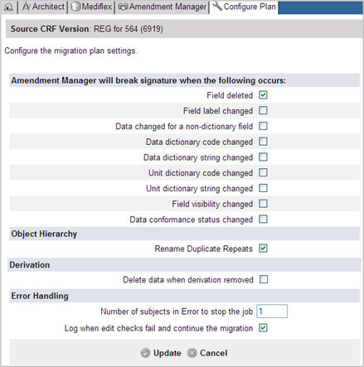
Amendment Manager: Overview
Rave tool used to apply a new CRF Version to existing subjects
Why is it called the Amendment Manager?
Mid-study eCRF changes are often due to protocol amendments
Changes to eCRFs require a new Rave CRF Version
Subject data must be “migrated” to the new CRF Version
Migration tool to help manage the roll out of protocol amendments resulting in eCRF changes to studies that have already gone live
Authorized users can plan for and execute migrations from one version to another
Notes:
ANIMATIONS…
Amendment Manager is used to apply a new CRF version to existing subjects
In plain English, we’re talking about rolling out mid-study changes. Typically, these mid-study changes are required due to modifications to the study protocol, discovered errors in the existing CRF versions, or updated outputs requirements
Whenever there is a change required to eCRFs, a new CRF version is required
Amendment Manager is a tool that helps manage the roll-out of these changes once your study has gone Live
Think about how this works in the paper world:
If a site is already collecting data for a subject on a specific set of case report forms, you would need to develop the new case report forms and send them out to the site so they could transfer over the data and start using the updated version of forms
The same things need to occur in an electronic environment, and Amendment Manager helps you to do them

Slide 16
Medidata Balance
Randomization and Trial Supply Management

Slide 17
Balance: Overview
Balance is the module that performs
Randomization
Trial Supply Management
Web-based solution
Rave EDC interface for randomization and dispensation
Creates process logs to track errors and statistics
Single Vendor support

Slide 18
Balance: Key Concepts
Rave
Balance
Randomization Form
Randomize Subject (Subject, Factor/state...)
API
Randomization Algorithm
Subject Randomized (Subject, Arm, Strata…)
Randomization CF
Dispensation
Form
Dispense to Subject (Subject, Visit...)
API
Dispense Algorithm
Dispense Items (Subject, visit, ItemID1, ItemID2,…)
Dispensation CF

Slide 19
Balance Randomization
Balance allows the following kinds of studies:
Basic – Design clinical trials and manage the associated supplies.
Study with single randomization
Cohort – Cohort studies compare a particular outcome in several groups that differ by a certain characteristic (eg. biomarker, site, …).
Parallel randomizations
Treatment Period – Studies with treatment periods support prospective by-design adaptive trials where subjects are re-randomized or force-allocated from one set of treatment regimes to another.
Consecutive randomizations
Additionally, for Basic and Cohort study designs, you can choose either:
Randomization-only –Balance handles the randomization.
Randomization and Supplies Management (RTSM) – Balance handles the randomization and supply chain.
RTSM is required for Multiple Treatment Period studies.
*For certain trial designs

Slide 20
Balance: randomization methods
Dynamic Allocation (minimization)
Allocates treatment to subjects based on the imbalance of treatments previously allocated to similar subjects.
Minimization occurs within each factor level. Balance allows site and overall study as built-in randomization factors. Strat factors weights can be assigned.
Permuted Block
Generates either a stratified Permuted Block randomization schedule, or uploads a user provided schedule.
All selected strat factors are combined into strata.

Slide 21
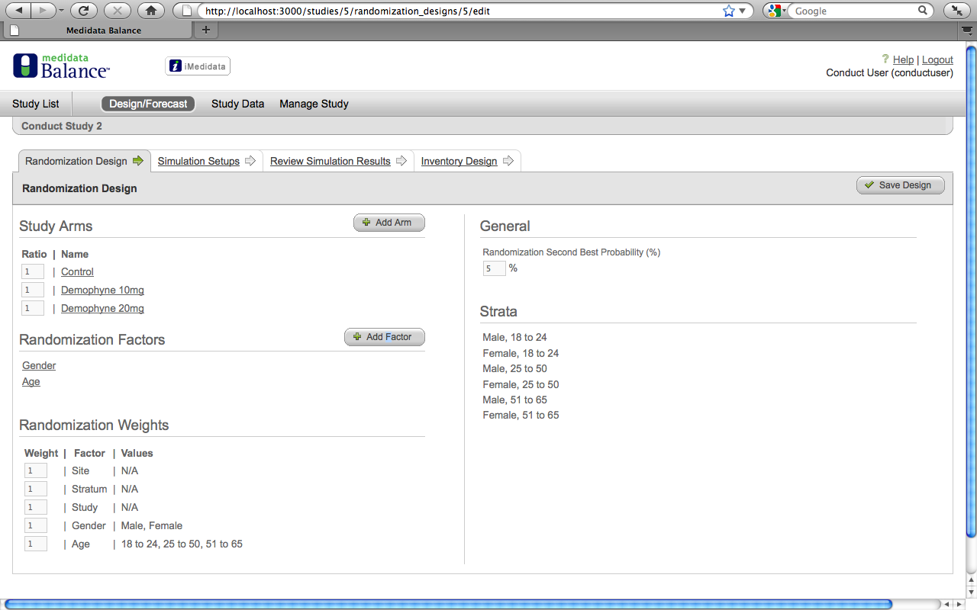
Balance: Key Functionality
Notes:
Balance

Slide 22
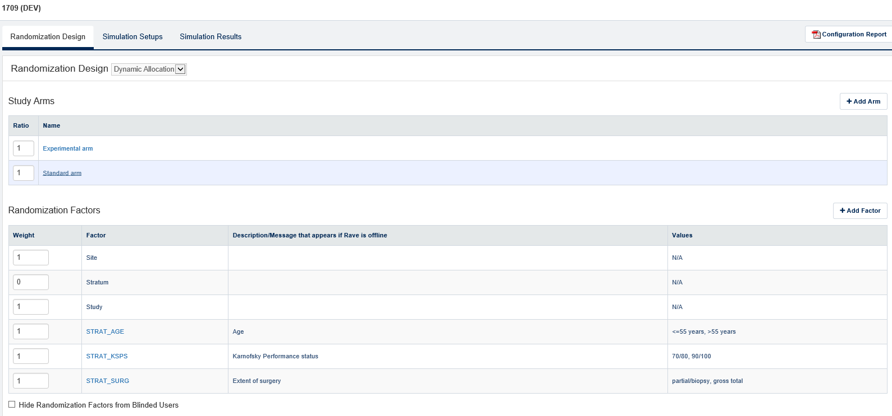
Treatment arms - specify for each treatment arm:
Name
Ratio
Stratification Factor – specify for each factor
Name
Weight
States (the unique factor levels for that factor) ← defined as such on CRF

Slide 23
Balance: minimization
Randomization Probability:
Random component: pure random allocations to counter deterministic algorithm.
Entered as probability in % (typical ranged 5-15%).
Two options:
Complete Randomization Probability – With probability equal to CRP, pick the next treatment assignment completely at random, with probability proportional to the target treatment ratios. A complete randomization probability value greater than 6% is recommended.
Second Best Probability – With probability equal SBP, pick the Second Choice Treatment as the next treatment assignment. If there are more than one, pick at random. Note: SBP only relevant if 3 or more treatments arms in equal ratios. Otherwise avoid.
Randomization factors:
At most 5 randomization factors (excluding site).
No more than 250 states in total (excluding site).
Site is a default stratification factor in ‘Dynamic Allocation’. In order to remove it, its factor weight must be set to 0.
Max 7 binary or 5 trinary

Slide 24
Balance: minimization
 | EORTC threshold | Balance
Imbalance function for arm A (M strat facors) | Imb_{A} = ∑^{M}(# pts with identical strat level in arm A) | Imb_{A} = ∑^{M} w_{M}.((# pts with identical strat level in arm A)/ (# patients with identical strat level) - r_{A})
Decision | Choose arm with imbalance < min(Imb) + threshold | Choose arm with minimum imbalance
Description | Assign to arm minimizing total absolute imbalance | Assign to arm minimizing total relative imbalance
Properties | few forced allocation | balances well in small strata
r_{A} = target ratio. Example: in a 2:1 design the target ratios are ²/₃ , ¹/₃

Slide 25
Example: new patient
 | Arm A (2) | Arm B (2) | Arm C (1) | Total
Male Female | 37 33 | 38 35 | 24 20 | 99 88
Site 111 | 5 | 4 | 0 | 9
Total | 70 | 73 | 44 | 187
Trial with 2 strat factors (gender and site): allocation ratio 2:2:1
New patient enrolled: Male from site 111.
EORTC | Arm A (2) | Arm B (2) | Arm C (1) | Total
Male | 37 | 38 | 24 | 99
Site 111 | 5 | 4 | 0 | 9
Total Imb | 37+5=42 42 x (3/4) = 31.5 | 38+4=42 42 x (3/4) = 31.5 | 24+0=24 24 x (6/4) = 36
Min Imb = arm A or B → random allocation between A or B

Slide 26
Example: new patient
 | Arm A (2) | Arm B (2) | Arm C (1)
Male Female | 37 33 | 38 35 | 24 20 | 99 88
Site 111 | 5 | 4 | 0 | 9
New patient: Male, site 111.
Suppose the new patient is randomized to arm A
Medidata | Arm A (2) | Arm B (2) | Arm C (1)
Male (99 + 1) | |(38/100) – (2/5)| + |(38/100) – (2/5)| + |(24/100) – (1/5)| = 0.02 + 0.02 + 0.04 | |(37/100) – (2/5)| + |(39/100) – (2/5)| + |(24/100) – (1/5)| = 0.03 + 0.01 + 0.04 | |(37/100) – (2/5)| + |(38/100) – (2/5)| + |(25/100) – (1/5)| = 0.03 + 0.02 + 0.05
Site 111 (9 + 1) | |(6/10) – (2/5)| + |(4/10) – (2/5)| + |(0/10) – (1/5)| = 0.20 + 0.00 + 0.20 | |(5/10) – (2/5)| + |(5/10) – (2/5)| + |(0/10) – (1/5)| = 0.10 + 0.10 + 0.20 | |(5/10) – (2/5)| + |(4/10) – (2/5)| + |(1/10) – (1/5)| = 0.10 + 0.00 + 0.10
Total Imb | = 0.08 + 0.40 = 0.48 | = 0.08 + 0.40 = 0.48 | = 0.10 + 0.20 = 0.30
If Arm A | Arm A (2) | Arm B (2) | Arm C (1)
Male (100) | 37+1=38 | 38 | 24
If Arm A | Arm A (2) | Arm B (2) | Arm C (1)
Obs ratio | ³⁸/₁₀₀ | ³⁸/₁₀₀ | ²⁴/₁₀₀
Target ratio | ²/₅ | ²/₅ | ¹/₅
→ Results in 38% males in arm A. What is the ideal proportion?
Difference | 0.38-0.40 = 0.02 | 0.38-0.40 = 0.02 | 0.24-0.20 = 0.04

Slide 27
Example: new patient
 | Arm A (2) | Arm B (2) | Arm C (1)
Male Female | 37 33 | 38 35 | 24 20 | 99 88
Site 111 | 5 | 4 | 0 | 9
New patient: Male, site 111.
Medidata | Arm A (2) | Arm B (2) | Arm C (1)
Male (99 + 1) | |(38/100) – (2/5)| + |(38/100) – (2/5)| + |(24/100) – (1/5)| = 0.02 + 0.02 + 0.04 | |(37/100) – (2/5)| + |(39/100) – (2/5)| + |(24/100) – (1/5)| = 0.03 + 0.01 + 0.04 | |(37/100) – (2/5)| + |(38/100) – (2/5)| + |(25/100) – (1/5)| = 0.03 + 0.02 + 0.05
Site 111 (9 + 1) | |(6/10) – (2/5)| + |(4/10) – (2/5)| + |(0/10) – (1/5)| = 0.20 + 0.00 + 0.20 | |(5/10) – (2/5)| + |(5/10) – (2/5)| + |(0/10) – (1/5)| = 0.10 + 0.10 + 0.20 | |(5/10) – (2/5)| + |(4/10) – (2/5)| + |(1/10) – (1/5)| = 0.10 + 0.00 + 0.10
Total Imb | = 0.08 + 0.40 = 0.48 | = 0.08 + 0.40 = 0.48 | = 0.10 + 0.20 = 0.30

Slide 28
Example: new patient
 | Arm A (2) | Arm B (2) | Arm C (1)
Male Female | 37 33 | 38 35 | 24 20 | 99 88
Site 111 | 5 | 4 | 0 | 9
New patient: Male, site 111.
Medidata | Arm A (2) | Arm B (2) | Arm C (1)
Male (99 + 1) | 0.08 | 0.08 | 0.10
Site 111 (9 + 1) | 0.4 | 0.4 | 0.2
Total Imb | = 0.08 + 0.40 = 0.48 | = 0.08 + 0.40 = 0.48 | = 0.10 + 0.20 = 0.30
Wghtd Imb | = 10 x 0.08 + 0.40 = 0.84 | = 10 x 0.08 + 0.40 = 0.84 | = 10 x 0.10 + 0.20 = 1.20
If gender more important than site: give more weight in set-up

Slide 29
Medidata: minimization
Published: Generalized multidimensional dynamic allocation method. Lebowitsch et al, Stat in Med 2012.
Especially useful for stratification factors with small categories such as “site”.
Balance set-up allows for:
Study factor: additional factor counting all patients. Helps to balance the total treatment arms.
Stratum factor: additional factor that counts patients with the exact same stratification stratum (ie. all factors identical)
Note: the algorithm retrieves values when randomizing → if the database changes, the modified values are used (eg. patient removed, strat value edited, …).

Slide 30
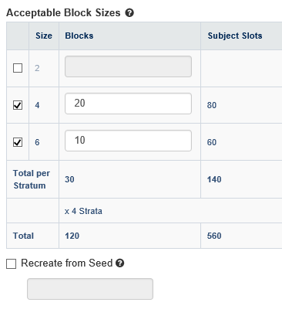
Balance: permuted blocks
Permuted block allocation.
Either upload list or generate list.
Unequal arm ratio possible (eg 2:2:1)
Variable block length possible
Randomization factors:
At most 5 randomization factors.
No more than 250 states in total.
Site or country is possible.
Example:
2 binary strat factors = 4 strata
2 arms in 1:1 (block size = 2xN)

Slide 31
BALANCE: capping
Capping allows to stop enrolling new patients at specific limits.
Capping can be done at screening or randomization
Capping can be based on:
Total sample size
Nbr per treatment arm
Nbr for a specific factor level (eg. male)
Nbr for a specific stratum

Slide 32
BALANCE: simulations
BALANCE has an in-built simulation tool.
Generates data based on the design and presents results summarized overall and per stratification factor.
Nbr of runs, sample size and proportions for each strata must be given.
BUT:
Limited nbr of runs possible
Number of Runs <= 1000.
Total Number of simulated Subjects <= 250000 (eg. 1000 sample size = limited to 250 runs)
Site = accrual equally spread
No info on non-included factors
Individual data can be downloaded in csv

Slide 33
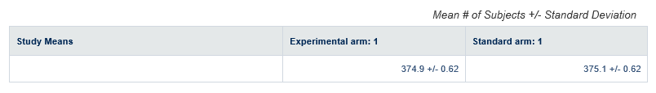
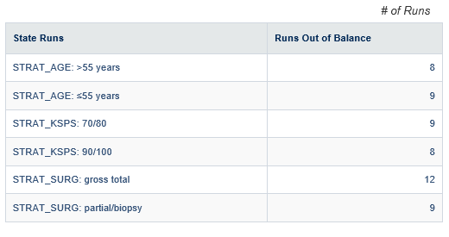
Balance simulations
Present:
Mean (SD)
Minima
Runs out of balance (diff > 1)

Slide 34
Medidata Export
Reporting: SAS On Demand

Slide 35
Export
Reporting is the module that performs
Standardized reports and data representation
Data export
Web-based solution
Rave EDC interface for randomization and dispensation
Creates process logs to track errors and statistics
Single Vendor support

Slide 36
SAS On Demand
Allows study exports
CSV, TXT,
SAS version 6-9
SAS XPORT (transport files)
End result is sent via email and/or FTP link
Can be scheduled in advance
Export possible on form level
Other restrictions possible via web services
Incremental data can be exported
From last export or from cut-off date

Slide 37
SAS On Demand
Data exported as SAS7BDAT files
One file per form
Formats: no study defined formats. All formats are either:
Text
Numeric
Date
Single data point exported in several variables

Slide 38
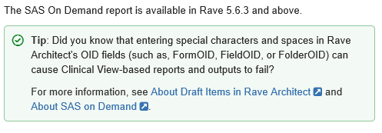
SAS On Demand
Two options for “view type”:
RAW: data as entered by user in character format (regardless of variable format).
REGULAR: data entered by user in character format and in target variable format
 |  | RAW | REGULAR
Date | “Around easter 2004” | “Around easter 2004” ($ text format) | . (DDMMYYY format)
Numeric | “> 100” | “> 100” ($ text format) | . (Num format)

Slide 39


SAS On Demand
Text Variable
Text variable = text of the chosen category
Coded variable = code defined in set-up
Coded Variable

Slide 40

SAS On Demand
Dates are exported in various formats
DATE: date format
DATE_RAW: text format
DATE_INT: date format corrected for incomplete date (set-up during design)
DATE components: numeric (day, month, year)
Incomplete day: entered with unknown day.

Slide 41
Wrap-up

Slide 42
Design considerations
Medidata system is built towards a single version approach
Extensive development and testing possibility
Once ‘live’ – single version is preferred.
Minimization possible but limited to single randomization studies.
Parallel or consecutive randomizations: only possible with block design
Learning process still ongoing
First studies will require a lot of setting up even for simple tasks.
Recycle for further studies (global library, import functions, …)

Slide 43
Use considerations
Medidata comes with a strong emphasis on roles/permissions for its users
Personalized version and access
Permissions are tied to certificates
Medidata help =
Most functionality is clear from the name
1st line help usually of the type: “To design a cohort study, click the option ‘cohort study’ from the design menu”.
eLearnings (online videos) rarely helpful: designed for certification
Knowledge Space = extensive, helpful but difficult to search
Frequent updates: dedicated reviewer?

Slide 44
Finally …
Currently 3 studies in development
1709 – entering UAT testing
1417 LCG (REACTION) and 1553 SPECTArare - development
Extensive documentation and courses but most is learned via doing.
Example: edit checks do not distinguish 0 from ‘EMPTY’. Code values = 0 must be avoided.
Custom functions:
Short sections of programming code (C#)
Allows modifications or functionalities otherwise unavailable.
Literally inserts new code in the software! Potentially dangerous.
1709 = 96 custom functions

Slide 45
EXTRA SLIDES

Slide 46
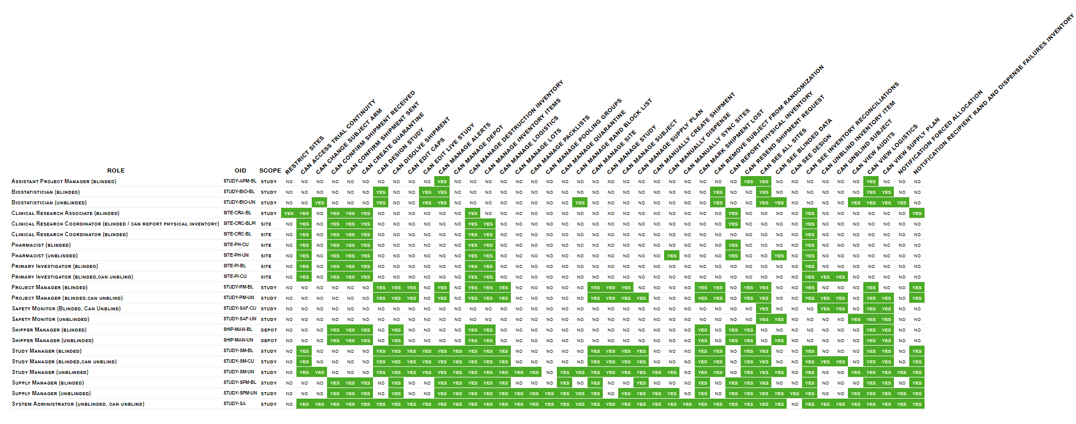

Slide 47
Targeted SDV: Overview
Targeted SDV is a Rave product that allows sponsors to reduce the number of SDV’s performed on a Rave study
Targeted SDV is a process by which certain source documents are verified
Less than 100% SDV is called “partial SDV” by the pharmaceutical industry
Sponsor’s responsibility to ensure that trials are adequately monitored using ICH E6 GCP guidance
Monitors are responsible for conducting SDV to check:
All the data required by the protocol is reported accurately on the CRFs and is consistent with the source documents
Notes:
ANIMATIONS…
According to the Good Clinical Practice Guidance or GCP
It is the sponsor’s responsibility to ensure that trials are adequately monitored
One of the many purposes of trial Monitoring is to verify that the reported trial data is accurate, complete and verifiable from source documents. (for example patient charts, X-Rays, tests, etc…
In terms of the Extend and nature of Monitoring the GCP guidelines state that the sponsor should determine the appropriate extend and nature of monitoring, based on specific considerations such as the objective, purpose, design, complexity, blinding, size and end-points of the trial
We see here a very basic example of how source document verification is performed and any one involved in this process. So in this case the process begins with the subject during a visit, and the nurse/doctor recording the blood pressure on the patient chart… then we see here the site coordinator entering the data from its source to the EDC system, and lastly we see here the Monitor verifying that the data in the eCRF matches the source data

Slide 48

Medidata Platform for Clinical Development
Resource Management
Strategy & Planning
Build & Set-Up
Execution
Site Quality Management
EDC/CDMS
Contracting
Targeted SDV
Study Build
Monitoring
Global Library
Safety Gateway
Reports & Extracts
Predicted Recruitment
Site Payments
eLearning
Legacy/Third-Party Systems

Slide 49

Targeted SDV: Key Benefits
More efficient and effective Site monitoring to reduce time and costs without compromising data integrity
Cost Effectiveness: enables risk-based site monitoring
Scalability: Reap the partial SV benefits from more studies
Flexibility: Design an SDV plan for study, site group or site level
Ease-of-Use: Monitors perform SDV activities in the same manner as they do with 100% SDV
Robust Control: Full control and auditability to support sponsors’ regulatory compliance strategy
Visibility: Track site SDV progress and data integrity within a single system
Notes:
ANIMATIONS…
Summarize the slide info...

Slide 50


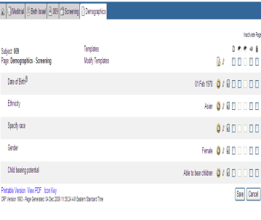

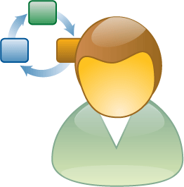

Targeted SDV: Key Processes
Define SDV Requirements
Configure Targeted SDV
Enter Subjects
into Rave
Create Block Plans
Set up Excluded Subjects
Sponsor
Sponsor or
Medidata PS
Activate Block Plans
Investigator
Adjust SDV Plan/
Override Subject SDV Formula
Evaluate Site Performance
Perform SDV
Study/Data
Manager
Study/Data
Manager
Monitor (CRA)
Optional Steps
Notes:
ANIMATIONS…
Summarize the slide info...

Slide 51
Targeted SDV: Key Concepts
Build SDV Plan
Assign Subjects
Perform and Track SDV
Review Site Quality
Adjust SDV plan
Block plan creation
Subject exclusion rule
Estimated SDV ratio
Plan activation
Subject enrollment
Balanced subject assignment
Site visit planning
Data fields verification
Study and site SDV progress
# and type of SDV issues
Remedy actions for ‘identified’ sites
New plan creation
Additional SDV block
Subject SDV override
Efficiently build, execute and track partial SDV plan completely within Rave
Notes:
ANIMATIONS…
First of all, Requirements for SDV must be defined
Summarize the slide info (use the workflow)…

Slide 52
Targeted SDV: Key Concepts (cont…)
Build different SDV requirements for different sites, site groups and regions, for example:
High performing sites in US and EU: safety variables ONLY
Low performing sites in US and EU: safety and primary variables
New sites in Asia and Latin America: all variables (100%)
Treat subjects of one site differently based on enrollment date, for example:
100% SDV for the first 2 subjects for each site
Safety data for the rest of subjects
Change the SDV requirement based on the actual site performance
Subjects that are not defined in Targeted SDV will use default SDV requirement built in architect
Configurability
Notes:
ANIMATIONS…
Targeted SDV will allow you to setup different plans depending on the business needs
You can build SDV plans that apply to all subjects in a study, or SDV plans by site or site groups
For example, you can see setup an SDV plan to only review safety variables for sites with proven high performance, while other sites with a lower performance can be setup for a higher SDV level, so for instance to verify the safety and primary variables only
At the same time, new sites for which no historic performance is known or sites where, due to regulatory concerns partial SDV is not allowed, you can set it up at 100% SDV
In addition, subjects within the same site can easily be set up to be distributed across the different plans according to different needs
For example, the first 2 subjects can be setup to be 100% SDV, AND then only safety data for the rest of the subjects

Slide 53
Targeted SDV: Key Functionality
Block Plan
Defines how subjects are to be distributed across blocks. Block plans can be created at the Study Group, Site Group and Site levels
Block
Defines how subjects assigned to the block are to be distributed across tiers linked to that block
Tier
A set of eCRF folders, forms and fields that have specific rules to define what data points need to be verified
Block Plans, Blocks and Tiers
Tier 1
(All Data)
2 subjects, Full SDV
Block 1
(5 subjects)
Tier 2
(Safety Data)
2 subjects, Partial SDV
Block Plan
Tier 3
(No SDV)
1 subjects, No SDV
Tier 4
(Primary Efficacy Data)
5 subjects, Partial SDV
Block 2
(10 subjects)
Tier 5
(100% of Visits 1,3 & 5)
5 subjects, Partial SDV
Notes:
ANIMATIONS…
Block Plans
Define how Subjects are to distributed across Blocks
Blocks
Define how Subjects assigned to that Bock are to be distributed across Tiers
Tiers
A Tier is defined as a collection of forms. Each Tier is named and can have any arbitrary collection of forms and fields from all to none and those EDC forms will be identified as belonging to that ‘Tier’

Slide 54
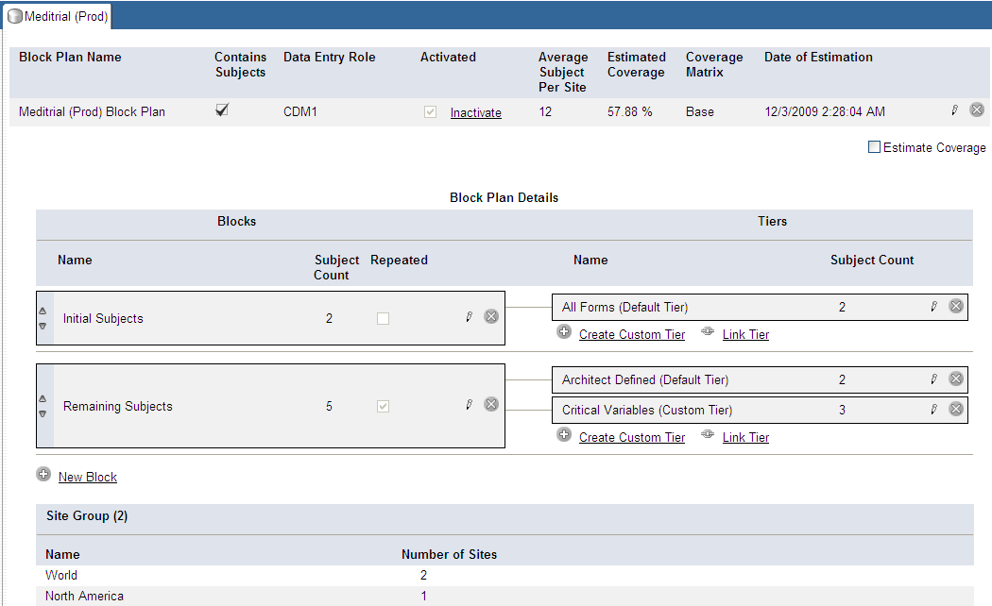
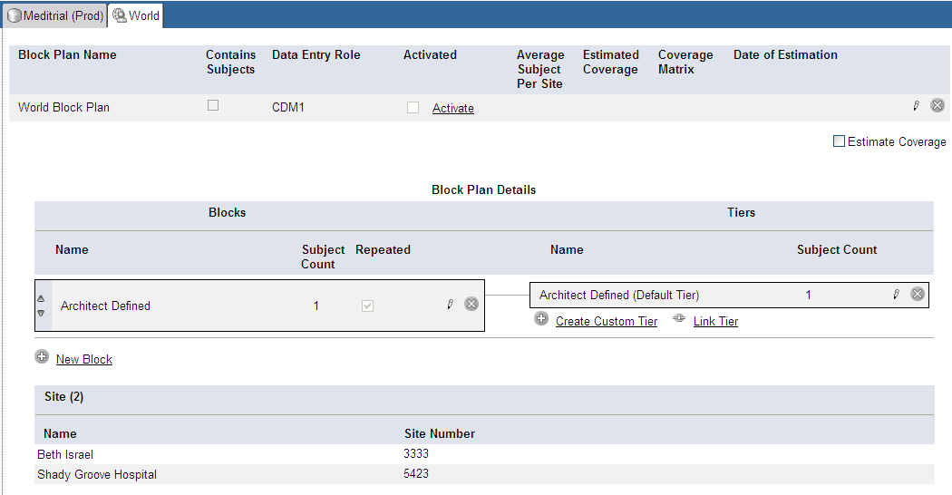
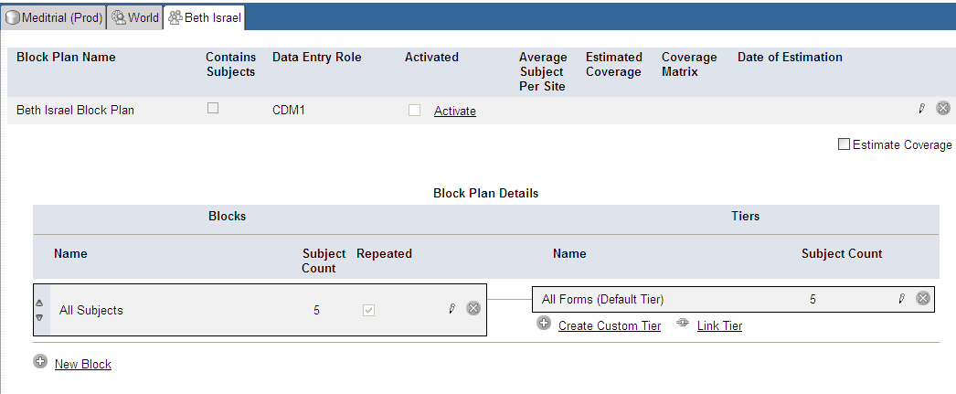
Targeted SDV: Key Functionality (cont…)
Study Group Block Plan
All Sites will use this Block Plan unless a Site Group or an individual ‘Site Block Plan’ is defined
Site Group Block Plan
Each Site within the Site Group will use this Block Plan unless an individual ‘Site Block Plan’ is defined
Site Block Plan
This Block Plan will override the Study and Site Group Block Plans
Block Plans
Notes:
ANIMATIONS…
Block Plan
The Block Plan Describes how subjects are distributed across defined Tiers
Block Plans can be created for the Study Group, Site Group and Site

Slide 55
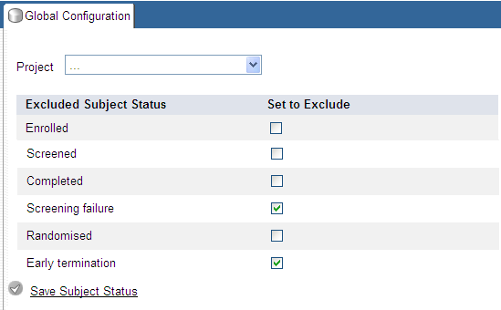
Targeted SDV: Key Functionality (cont…)
Exclude Subject Status
Users can designate which types of subjects will be excluded from the verification process across their entire study
Exclude Subject Status
Notes:
There is a Targeted SDV Global Configuration Report, where we canexclude Subjects of a certain status
This is also a separate report called Targeted SDV Configuration Report, which is a downloadable spreadsheet version for QC or sign off

Slide 56
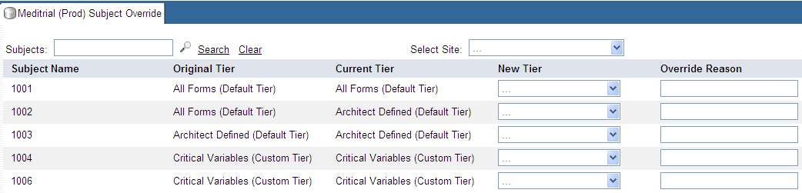
Targeted SDV: Key Functionality (cont…)
Subject Override
At any point during the course of the trial, subject verification requirements can be changed (Subject Override)
Only unsubmitted forms will be impacted by the change
Subject Override
Current Tier
New Tier
Override Reason
Notes:
Another report called Targeted SDV Management Report is where we can manually Override the TSDV plan for individual Subjects

